Slide 1
Digital Image processing 4
Dep. of Computer Science & Information Engineering, Asia University
Associate Professor
Rung-Sheng Chen

Slide 2
1.Review of Pillow
2.Review of scikit-image
3. PIL vs. scikit-image
4. low level DIP

Slide 3
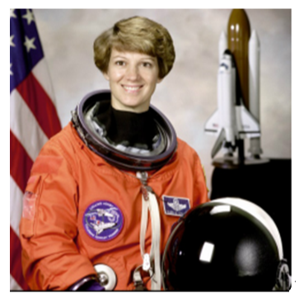
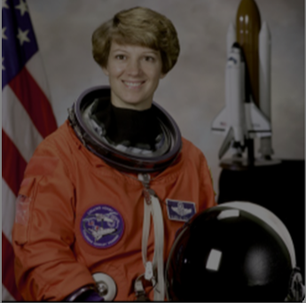
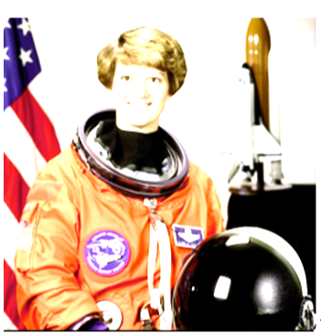
1.Review of Pillow
Image enhancement involves operations such as changing the contrast, brightness,
color balance, or sharpness of an image. Pillow provides an ImageEnhance module,
which has functions that can help you perform the earlier mentioned operations.
The enhance() function takes a float as an argument, which describes the factor which
we want to change the brightness of the image. A factor value less than 1 will
decrease the brightness and a factor value greater than 1 will increase the brightness
of the image. A factor value equal to 1 will give the original image as output.
from PIL import Image
img = Image.open(“G:/Computer Vision/newastronaut.png")
img.show()
from PIL import ImageEnhance
enhancer = ImageEnhance.Brightness(img)
enhancer.enhance(0.5).show()
enhancer.enhance(2).show()

Slide 4
2.Review of scikit-image Io module
Reading an image: As you know, reading an image is the most fundamental
operation you would like to perform. In scikit-image, the image can be read using the imread() function in the io module of the library.
import numpy as np
import matplotlib.pyplot as plt
from skimage import io
img = io.imread("G:/Computer Vision/newastronaut.png")

Slide 5
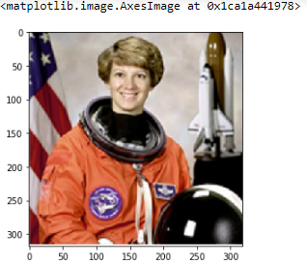
imshow
io.imshow(img)

Slide 6
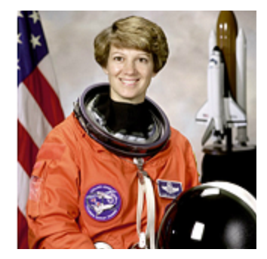
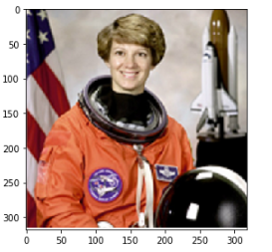
3 PIL vs. scikit-image
from PIL import Image
img = Image.open("G:/Computer Vision/newastronaut.png")
img.show() # in a separate image
print(img.size)
(512, 512)
from skimage import io
img = io.imread("G:/Computer Vision/newastronaut.png")
print(img.shape) # show at the same space
(512, 512,3)
io.imshow(img)

Slide 7
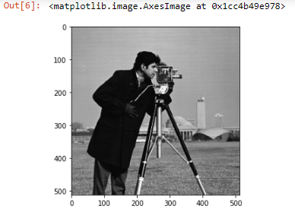
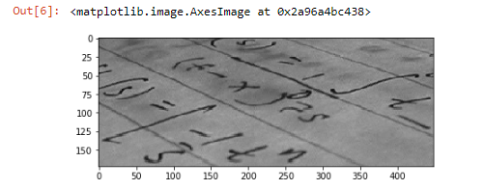
Multimodule import: io & data
from skimage import io, data
io.imshow(data.camera())
io.imshow(data.text())

Slide 8
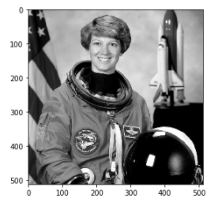
Color module
from skimage import io, color
img = io.imread("G:/Computer Vision/astronaut.png")
gray = color.rgb2gray(img)
io.imshow(gray)

Slide 9
Changing between color spaces
Grayscale:
This is one of the simplest color spaces both in terms of understanding and storing on a computer. Each pixel value in a grayscale image is a single value between 0 and 255, with 0 representing black and 255 representing white.
Grayscale images are also sometimes called black and white images but it is not entirely accurate. A black and white image means that the pixel values can only be either 0 or 255 and nothing in between.

Slide 10
Red, Green, Blue (RGB):
This is one of the most common color spaces that is
used in the image processing world and elsewhere.
Most images that you view over the internet or in your books are in the RGB space. In a typical RGB image, each pixel is a combination of three values, each representing a color in red, green, and blue channels. White color in RGB space is written as (255, 255, 255) and black is written as (0, 0, 0). Red, green, and blue are represented by (255, 0, 0), (0, 255, 0), and (0, 0, 255) respectively.

Slide 11
4. low level DIP
Until now, we may already how to read and save an image from the chosen route. And we also have learned two packages for reading the image in, there are pillow and skimage.
The following will give the materials for low level DIP.

Slide 12
Low-level processes involve primitive operations such as image processing to reduce noise, contrast enhancement, and image sharpening.
A low-level process is characterized by the fact that both its inputs and outputs are images.

Slide 13
After having understood the basics of image processing and their libraries (pillow and skimage), from now on, we will extend our understanding by looking at some fundamental concepts such as kernels, convolution, filters, and basic image features.

Slide 14
Kernels
As you saw in the previous section, we used a derivative mask to an calculate image derivative. Before going further , let's formally define what these masks are. A lot of times in texts/research papers/books related to image processing, we use the terms mask, kernel, and filter interchangeably. What these essentially mean is a square matrix of numbers that is used to compute various properties or characteristics in an image. You have already seen an example of an image derivative. Some other common examples of such kernels/filters/masks are edge
detection, image blurring, and more. As you read through this chapter, you will see various examples of kernels that will help you understand this better.

Slide 15
Enhancing an image by applying some function on the pixel values is called filtering. The process of filtering focuses on the values of the neighborhood of a pixel and uses some to modify the value of the pixel. This is done by convolving the image matrix with a kernel. Therefore, for different filters, you can create different types of kernels. By convolving the image matrix with the kernel, you are basically taking a weighted average of the neighboring values. This method can be used to reduce noise in an image, create effects, and so on. . Types of filtering are as follows:

Slide 16
4-1image filters
The process of filtering focuses on the values of the neighborhood of a pixel and uses some to modify the value of the pixel.
Types of filtering are as follows:
Gaussian blur
Median filter
Dilation and erosion
Customs filters
Image thresholding

Slide 17
4-2 Gaussian blur
The ImageFilter library has an inbuilt function for the Gaussian blur. It takes a blur radius as input. The blur radius controls the number of neighboring pixels around the center pixels that are considered while applying the Gaussian blur.

Slide 18
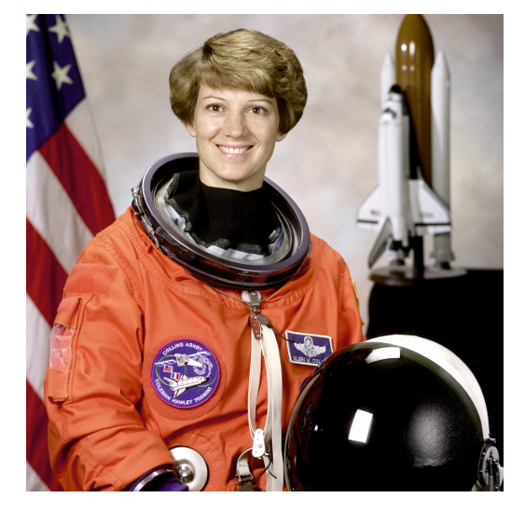
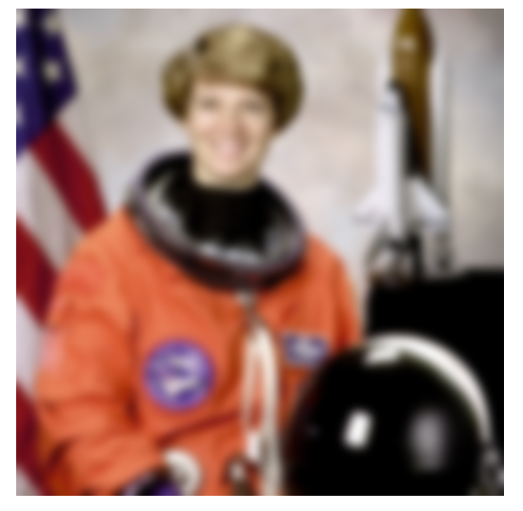
Code
>>>from PIL import Image
>>> from PIL import ImageFilter
">>> img = Image.open("G:/Computer Vision/newastronaut.png")
>>> blur_img = img.filter(ImageFilter.GaussianBlur(5))
>>> blur_img.show()
The following is the output of the preceding code:
Output of the Gaussian blur using Pillow; the image on the left is the original image and
the image on the right is the result of the Gaussian blur

Slide 19
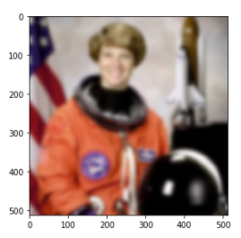
an example using skimage:
The filter module of the library provides a Gaussian filter, which takesthe image and the standard deviation (sigma) of the Gaussian kernel:
>>> from skimage import io, filters
>>> img = io.imread("G:/Computer Vision/newastronaut.png")
>>> out = filters.gaussian(img, sigma=5)
>>> io.imshow(out)
>>> io.show()
Output of the Gaussian blur using skimage; the image on the left is the original image and the image on the right is the result of the Gaussian blur

Slide 20
4-3 Median filter
This is a very simple filter that returns the median value from the pixel and its neighbors. pillow can provide built-in functions for this filter.

Slide 21
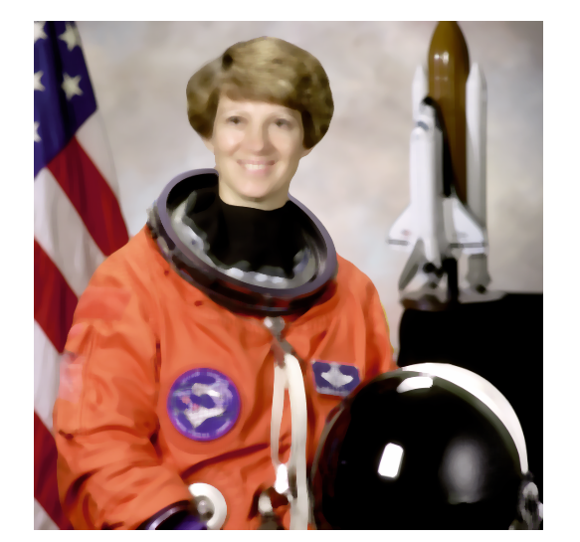
>>> from PIL import Image
>>> from PIL import ImageFilter
>>> img = Image.open("G:/Computer Vision/newastronaut.png")
>>> blur_img = img.filter(ImageFilter.MedianFilter(7))
>>> blur_img.show()

Slide 22
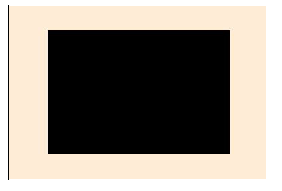
4-4 Edge detection
Consider a solid black box (refer to Figure ). All the pixels within the black box
have similar pixel values, whereas, the pixel values on the boundary or the edge vary
significantly from their neighboring pixels.

Slide 23
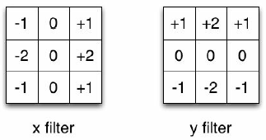
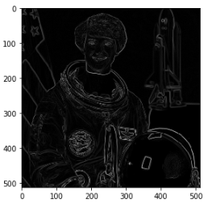
The kernel used in the Sobel edge detector algorithm is as follows
Here is a code to find edges using the scikit-image:
from skimage import io
from skimage import color
from skimage import filters
img = io.imread("G:/Computer Vision/astronaut.png")
img = color.rgb2gray(img)
edge = filters.sobel(img)
io.imshow(edge)

